Slide 1
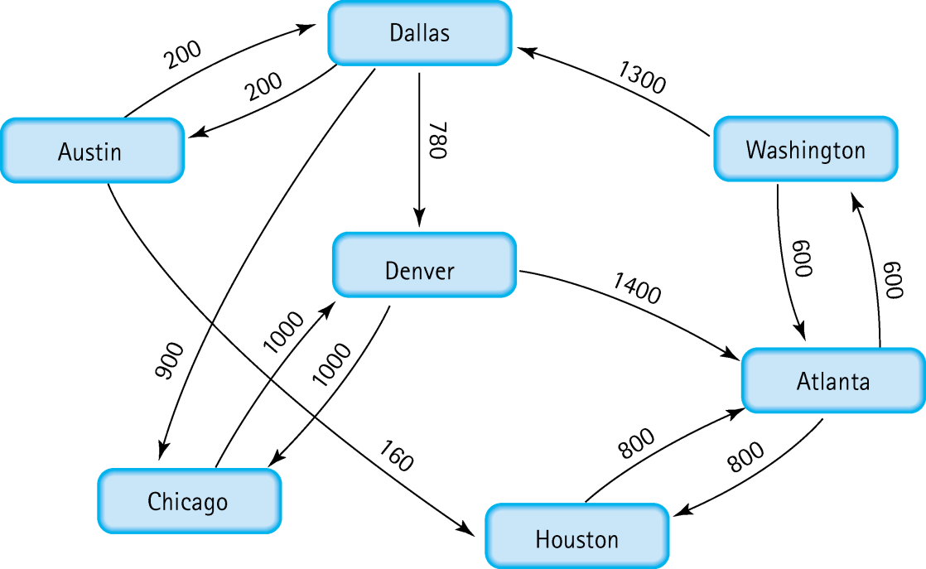
Traveling | Austin & Washington
How do I travel from Austin to Washington?
What about from Washington to Austin?
How to write a program to do so?
Notes:
Austin – Houston – Atlanta – Washington
Austin – Dallas – Denver – Atlanta – Wash
Others

Slide 2
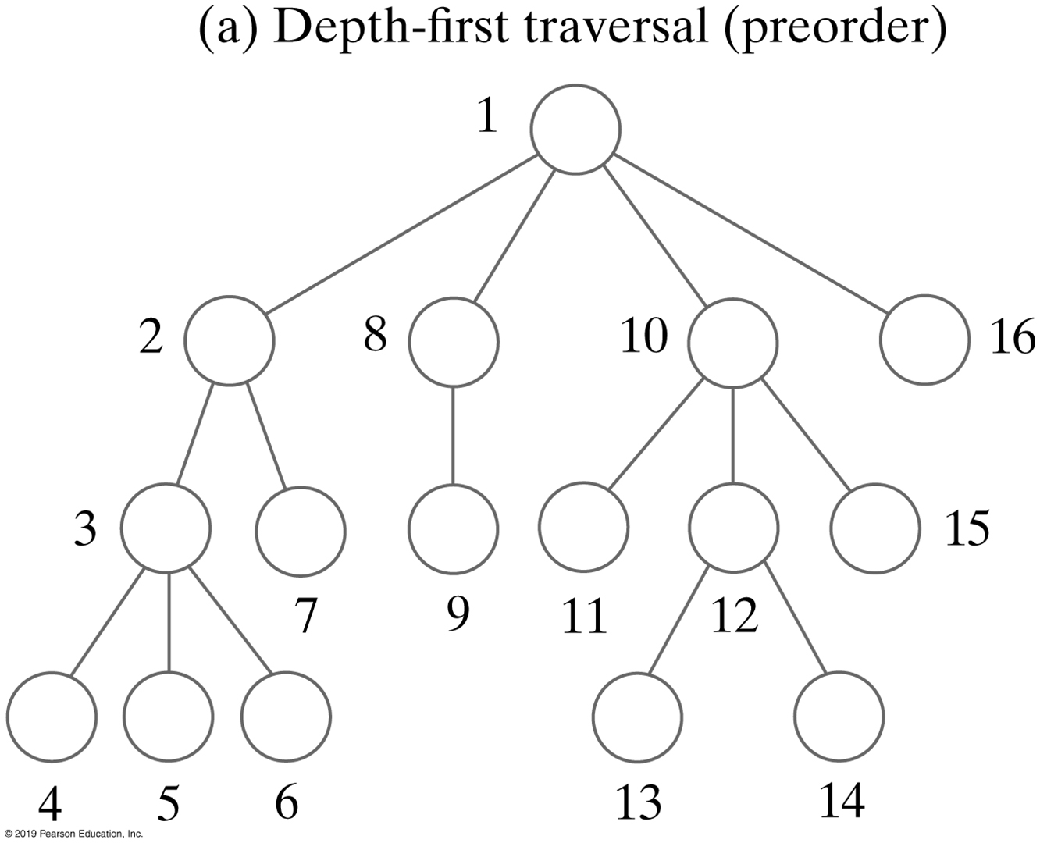
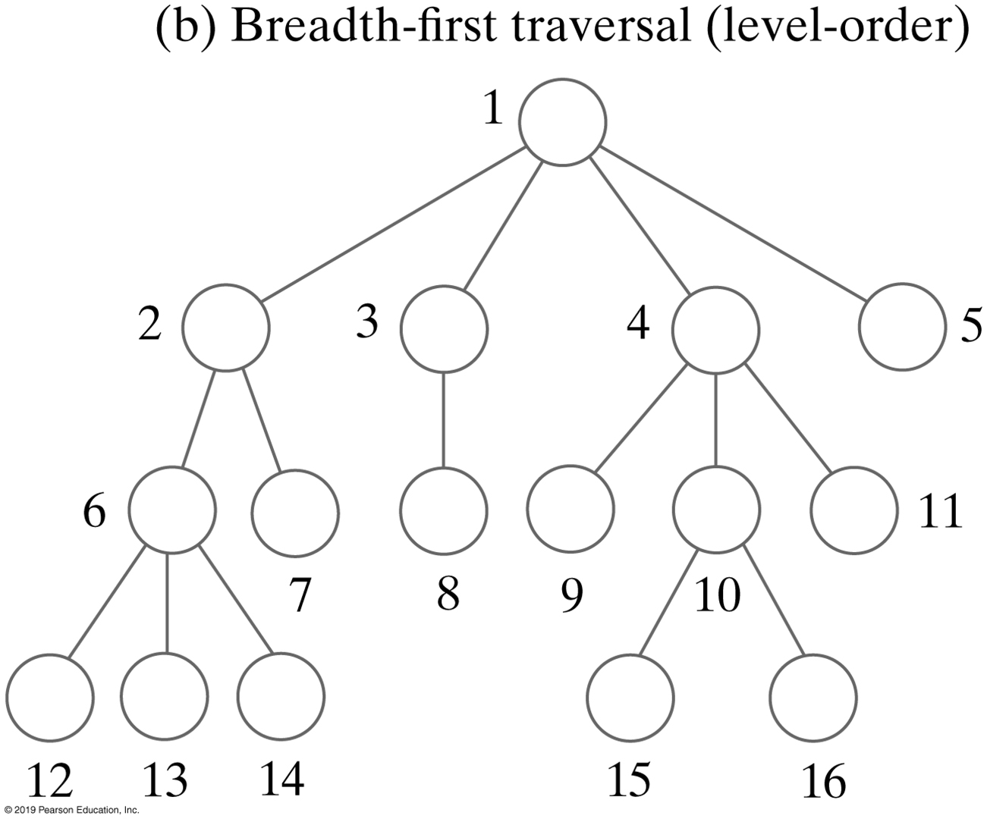
Graph Traversals | Review
You can determine how to travel between Austin and Washington using a graph traversal
Notes:
Which traversal?

Slide 3
Depth-First Traversal
Use a stack to save unvisited siblings while descendants are visited
Ensure they will be visited after any decedents that are subsequently pushed onto the stack
Vertices are only pushed once
2
1
0
3
4
Visited order V₃ V₄ V₁ V₂ V₀
The stack after the visit
V₄
V₁
V₀
V₁
V₀
V₂
V₀
V₀
The stack operations after Push V₀ Pop Push V₂ Pop
The visit Push V₁ Pop
Push V₄
Pop
Notes:
Depth-first -> pre-order
Visiting order: arbitrary starting at 3

Slide 4
Depth-First Searching (Austin to Washington)
DepthFirstSearch (non recursive)
Set found to false
stack.push(startVertex)
do
stack.pop(vertex)
if vertex = endVertex
Write final vertex
set found to true
else
write this vertex
push all adjacent vertices on stack
while !stack.IsEmpty and !found
if !found
write “Path does not exist”
stack
Austin
Notes:
Non recursive approach

Slide 5
Depth-First Searching (Austin to Washington)
DepthFirstSearch
Set found to false
stack.push(startVertex)
do
stack.pop(vertex)
if vertex = endVertex
Write final vertex
set found to true
else
write this vertex
push all adjacent vertices on stack
while !stack.IsEmpty and !found
if !found
write “Path does not exist”
stack
Austin

Slide 6
Depth-First Searching (Austin to Washington)
DepthFirstSearch
Set found to false
stack.push(startVertex)
do
stack.pop(vertex)
if vertex = endVertex
Write final vertex
set found to true
else
write this vertex
push all adjacent vertices on stack
while !stack.IsEmpty and !found
if !found
write “Path does not exist”
stack
Austin

Slide 7
Depth-First Searching (Austin to Washington)
DepthFirstSearch
Set found to false
stack.push(startVertex)
do
stack.pop(vertex)
if vertex = endVertex
Write final vertex
set found to true
else
write this vertex
push all adjacent vertices on stack
while !stack.IsEmpty and !found
if !found
write “Path does not exist”
stack
Austin
Houston
Dallas

Slide 8
Depth-First Searching (Austin to Washington)
DepthFirstSearch
Set found to false
stack.push(startVertex)
do
stack.pop(vertex)
if vertex = endVertex
Write final vertex
set found to true
else
write this vertex
push all adjacent vertices on stack
while !stack.IsEmpty and !found
if !found
write “Path does not exist”
stack
Austin
Houston
Houston
Atlanta
Dallas

Slide 9
Depth-First Searching (Austin to Washington)
DepthFirstSearch
Set found to false
stack.push(startVertex)
do
stack.pop(vertex)
if vertex = endVertex
Write final vertex
set found to true
else
write this vertex
push all adjacent vertices on stack
while !stack.IsEmpty and !found
if !found
write “Path does not exist”
stack
Austin
Houston
Atlanta
Washington
Atlanta
Dallas
Notes:
*We don’t include Houston - already visited
(must mark Houston as visited)

Slide 10
Depth-First Searching (Austin to Washington)
DepthFirstSearch
Set found to false
stack.push(startVertex)
do
stack.pop(vertex)
if vertex = endVertex
Write final vertex
set found to true
else
write this vertex
push all adjacent vertices on stack
while !stack.IsEmpty and !found
if !found
write “Path does not exist”
stack
Austin
Houston
Atlanta
Washington
Washington
Dallas
Notes:
This is only one of several paths
We have determined a path (that’s all we can say)
Is it our “best” choice? (We have not decided on what “best” is yet)

Slide 11
Breadth-First Traversal
Use a queue to save unvisited siblings
They will be visited before any decedents that are subsequently added to the queue
Vertices are only enqueued once
2
1
0
3
4
Visited order V₃ V₀ V₁ V₄ V₂
The queue after the visit
V₀
V₁
V₄
V₁
V₄
V₄
V₂
V₂
The queue operations after Enqueue V₀ Dequeue Dequeue Dequeue
The visit Enqueue V₁ Enqueue V2 Enqueue V₄
Dequeue
Notes:
Breadth-First -> Level order

Slide 12
Breath-First Searching (Take Home Exercise)
BreadthFirstSearch
Set found to false
queue.enqueue(startVertex)
do
queue.dequeue(vertex)
if vertex = endVertex
Write final vertex
set found to true
else
write this vertex
enqueue all adjacent vertices on queue
while !queue.IsEmpty and !found
if !found
write “Path does not exist”
Austin
front
back
queue
Austin
Houston

Slide 13
Breadth-First Searching
BreadthFirstSearch
Set found to false
queue.enqueue(startVertex)
do
queue.dequeue(vertex)
if vertex = endVertex
Write final vertex
set found to true
else
write this vertex
enqueue all adjacent vertices on queue
while !queue.IsEmpty and !found
if !found
write “Path does not exist”
Austin
front
back
queue
Houston
Dallas

Slide 14
Breadth-First Searching
BreadthFirstSearch
Set found to false
queue.enqueue(startVertex)
do
queue.dequeue(vertex)
if vertex = endVertex
Write final vertex
set found to true
else
write this vertex
enqueue all adjacent vertices on queue
while !queue.IsEmpty and !found
if !found
write “Path does not exist”
Austin
front
back
queue
Houston
Dallas

Slide 15
Breadth-First Searching
BreadthFirstSearch
Set found to false
queue.enqueue(startVertex)
do
queue.dequeue(vertex)
if vertex = endVertex
Write final vertex
set found to true
else
write this vertex
enqueue all adjacent vertices on queue
while !queue.IsEmpty and !found
if !found
write “Path does not exist”
Austin
Houston
front
back
queue
Dallas

Slide 16
Breadth-First Searching
BreadthFirstSearch
Set found to false
queue.enqueue(startVertex)
do
queue.dequeue(vertex)
if vertex = endVertex
Write final vertex
set found to true
else
write this vertex
enqueue all adjacent vertices on queue
while !queue.IsEmpty and !found
if !found
write “Path does not exist”
Austin
Houston
front
back
queue
Dallas
Atlanta

Slide 17
Breadth-First Searching
BreadthFirstSearch
Set found to false
queue.enqueue(startVertex)
do
queue.dequeue(vertex)
if vertex = endVertex
Write final vertex
set found to true
else
write this vertex
enqueue all adjacent vertices on queue
while !queue.IsEmpty and !found
if !found
write “Path does not exist”
Austin
Houston
front
back
queue
Dallas
Atlanta

Slide 18
* | Depth-First vs. Breath-First
Applications of BFT
Shortest Path & Minimum Spanning Tree
Peer to Peer Networks
Crawlers in Search Engines
Social Networking Websites
GPS Navigation Systems
https://www.geeksforgeeks.org/applications-of-breadth-first-traversal/

Slide 19
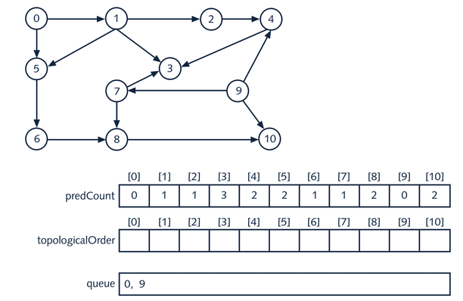
Topological Order | Breadth First Traversal

Slide 20
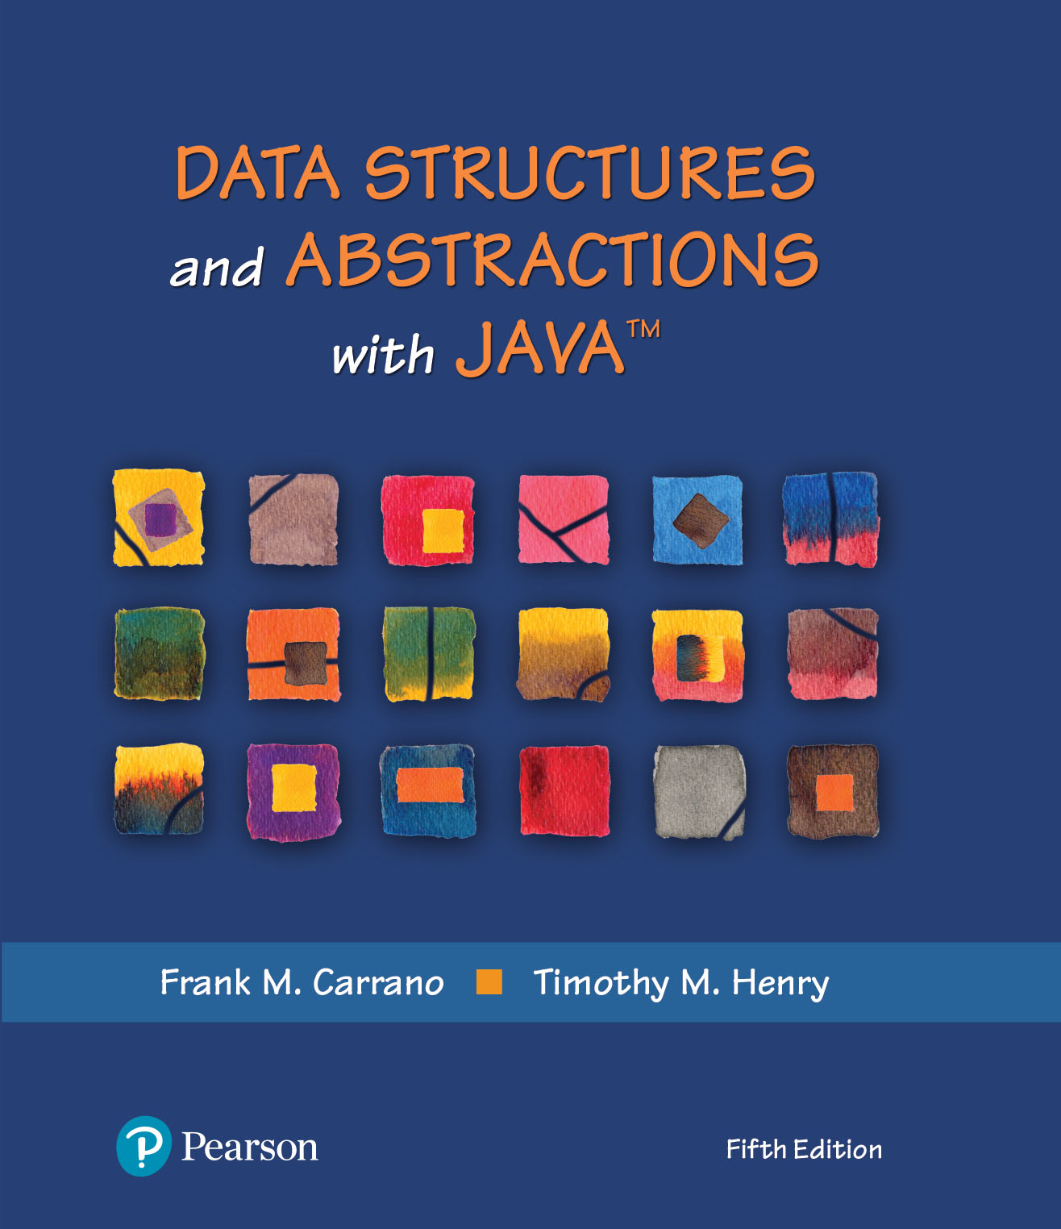
Graph Implementations
Ch. 30 – Graph Implementations

Slide 21
Additional Resource
Graph Theory
https://medium.com/tebs-lab/graph-theory-table-of-contents-97ccc62b09a6
Spanning Trees
https://www.tutorialspoint.com/data_structures_algorithms/spanning_tree.htm

Slide 22
Connectivity (Spanning Tree)
A
B
3
16
9
4
5
F
C
8
E
6
1
2
G
H
7
Connectivity vs. shortest path | Going from A to E
Notes:
The spanning tree of a graph (G) is a subset of G that covers all of its vertices using the minimum number of edges
https://www.educative.io/edpresso/what-is-a-spanning-tree

Slide 23
Determining Connectivity
Undirected graphs
Perform a DFT or BFT beginning at any vertex and verify that all vertices are visited
Just like the Review example
Digraphs
We will need to – perform a DFT or BFT beginning at all vertices and verify that all vertices are visited during every traversal
Use Warshall’s algorithm because it also determines which vertices are connected in an unconnected digraph

Slide 24
Warshall’s Algorithm
Based on the (mathematics) transitive property:
if a == b and b == c, then a == c
Generate a transitive closure matrix, T, which contains a 1 in T[i][j] if there is a path from Vi to Vj
Graph is connected if all elements of T are 1 except for its diagonal
2
0 1 2 3 4
0 0 1 0 1 0
1 0 0 1 1 0
2 0 0 0 0 0
3 0 0 0 0 1
4 1 0 0 1 0
0 1 2 3 4
0 0 1 1 1 1
1 1 0 1 1 1
2 0 0 0 0 0
3 1 1 1 0 1
4 1 1 1 1 0
1
0
3
4
An Unconnected Digraph
Its Adjacency Matrix
Transitive Closure Matrix, T
Notes:
Examples
0 -> 2 (0 -> 1 + 1->2)
0 -> 4 (0 ->3 + 3 -> 4)
From 2, we cannot go anywhere!

Slide 25
Transitive Closure Matrix | Warshal's Algorithm
// finds a path from vertex a to vertex c through vertex b
1. for (int b=0; b < n; b ++) // for each intermediate vertex, b
2. { for(int c=0; c< n; c++) // locate the paths from vertex b to vertex c
3. { if(t[b][c] == 1) // a path from vertex b to some vertex c has been found
4. { for(int a=0; a<n; a++) // find the paths to b from a, for all vertices a
5. { if(t[a][b] == 1 && a != c) // path to b from a has been found
6. t[a][c] = 1; // mark that the path from vertex a to vertex c exists
} // end for all a
} // end if
} // end for all c
10. } // end for all b
11. return t;
Notes:
https://iq.opengenus.org/transitive-closure-using-floyd-warshall-algorithm/
C++ code!

Slide 26
Spanning Trees
Contain all of the (graphs) vertices and a subset of its edges such that
Graph is connected; every vertex can be reached from every other vertex
Every undirected connected graph
Has at least one spanning tree
Contains a minimum number of edges (n-1)
If weighted, has one minimum spanning tree
2
e
1
b
2
2
1
1
c
0
a
3
0
0
d
3
3
f
4
4
4
Graph A
Two Spanning Trees of the Graph A
Notes:
https://www.tutorialspoint.com/data_structures_algorithms/spanning_tree.htm
Between the two spanning trees, which one is better?

Slide 27
Minimum Spanning Trees
Spanning tree of a weighted graph that minimizes the sum of the edge weightings; e.g., 11
2
3
1
1
9
8
3
0
2
5
4
2
3
1
1
How is it better?
3
0
2
5
4
Prim’s algorithm
Kruskal’s
Notes:
Two approaches
Prim’s algorithm
Kruskal’s

Slide 28
Prim’s (Generation Process) | MST
2
2
3
1
1
3
1
1
9
8
9
8
Added
0
0
3
3
2
5
2
5
4
4
Considered
2
2
3
1
1
3
1
1
8
8
9
0
9
0
3
3
2
5
2
5
4
4
MST
2
0 1 2 3 4
0 0 0 0 0 1
1 0 0 1 1 0
2 0 1 0 0 0
3 0 1 0 0 1
4 1 0 0 1 0
1
1
2
3
8
1
1
0
3
0
3
3
2
5
2
5
4
4
Notes:
From 0, 3 options: 1, 4 & 8
Pick 4 (because it’s the minimum, 5 unit, is the shortest path)
From 4, only 1 option: 3
From 3, only 1 option: 1
From 1, only 1 option, 2

Slide 29
Prim’s (Generation Process)
Place any vertex into the minimum spanning tree
Consider
The edges not currently in the tree from all the vertices currently in the tree
Add the edge with the minimum weight and its incident vertex to the tree
Repeat steps 2 and 3 until all vertices are in the tree
When a graph's edge weights are unique, it only has one minimum spanning tree
Prim’s (process) can begin at any vertex
Notes:
What did we do?

Slide 30
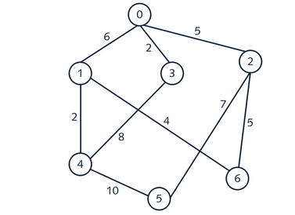
Airline Example
An airline needs to shut down the maximum number of connections but still be able to fly from between cities (none direct flights)
What are the options?
Airport connections

Slide 31
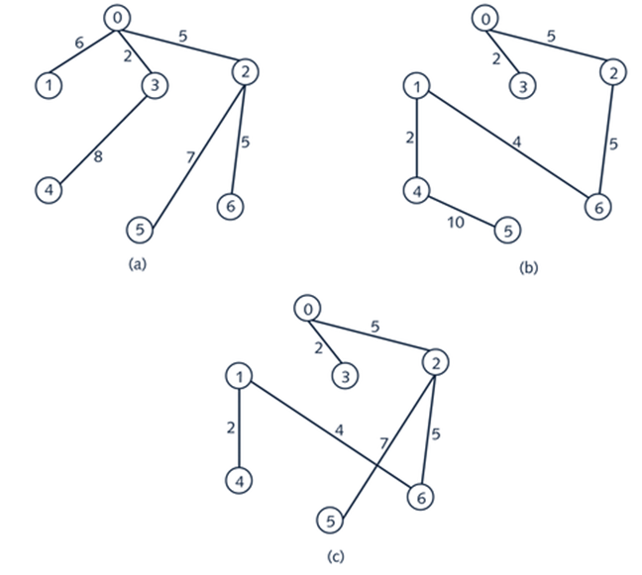
Possible Solutions
Cost factor = 33
Cost factor = 28
Spanning trees vs. MST
Cost factor = 25
Notes:
Spanning trees vs. MST

Slide 32
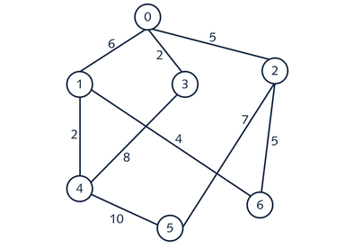
Activity | Airline Example (Prim’s)

Slide 33
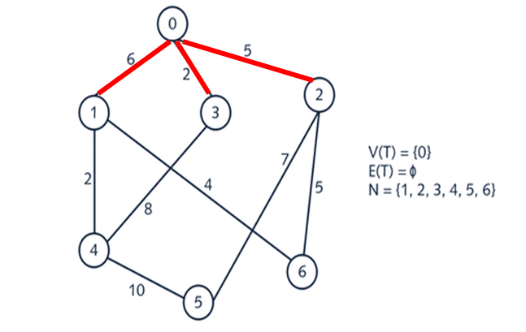
Prim’s Algorithm

Slide 34
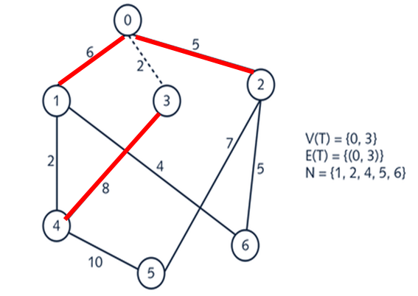
Prim’s Algorithm

Slide 35
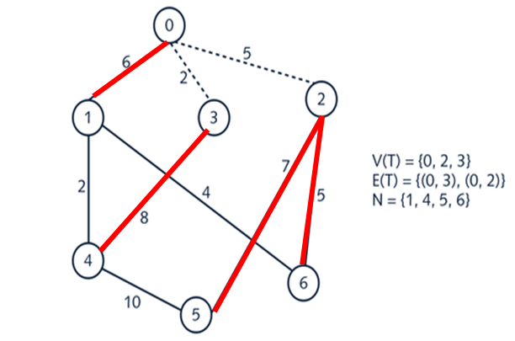
Prim’s Algorithm

Slide 36
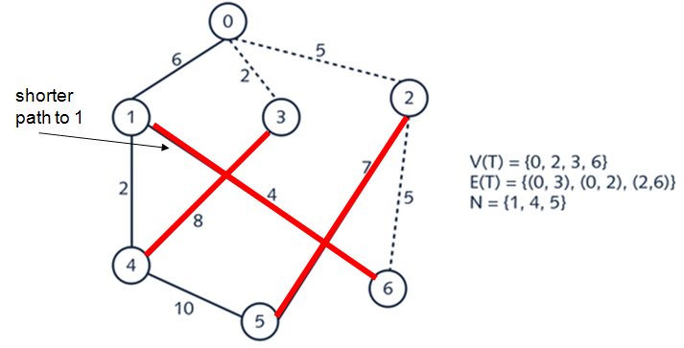
Prim’s Algorithm

Slide 37
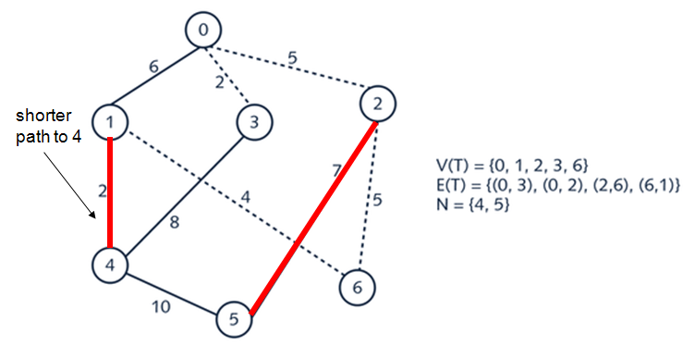
Prim’s Algorithm

Slide 38
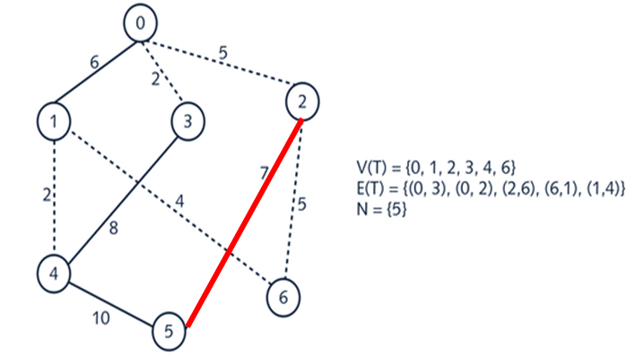
Prim’s Algorithm

Slide 39
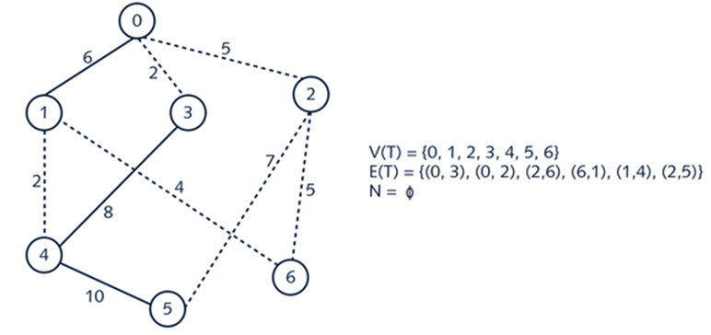
Prim’s Algorithm

Slide 40
Prim’s | Learning Activity
u1
10
u3
5
20
u0
20
10
5
u5
30
15
u2
15
u4
http://weierstrass.is.tokushima-u.ac.jp/ikeda/suuri/dijkstra/PrimApp.shtml?demo1
Notes:
https://www.javatpoint.com/prim-algorithm

Slide 41
Prim’s (Pseudo Code)
/* Array aCopy initialized to the adjacency matrix, Array mst initalized to an impossibly high edge weighting, noEdge. findMinWeightEdge returns the row, column, and weight of the minimum edge of those considered /*
1. verticesIncluded[0] = 0; // add vertex 0 to the tree
2. numVerticesIncluded = 1; // one vertex has been added to the tree
3. for (int i = 0; i < numberOfVertices; i++) // eliminate the edges to vertex 0
aCopy[i][0] = noEdge;
4. while (numVerticiesIncluded < numberOfVertices) // more vertices
5. { findMinWeightEdge(numberOfVertices, aCopy, verticesIncluded, numVerticesIncluded, rowMin, colMin, weightMin)
6. for (int i = 0; i < numberOfVertices; i++) // eliminate edges to included vertex
7. { aCopy[i][colMin] = noEdge;
8. }
9. mst[rowMin][colMin] =minWeight; // add minimum weighted edge to tree
10. mst[colMin][rowMin] =minWeiight;
verticesIncluded[numVerticiesIncluded] = colMin; // add the vertex to the tree
numVerticesIncluded++;
13. } //end while
14. return mst;

Slide 42
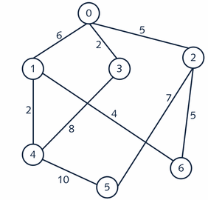
Kruskal’s Algorithm
Step 1. List all edges and weights
edge
weight
0 – 1 (6)
0 – 3 (2)
0 – 2 (5)
1 – 6 (4)
1 – 4 (2)
2 – 5 (7)
2 – 6 (5)
3 – 4 (8)
4 – 5 (10)
Now put the weight in order

Slide 43
Kruskal’s Algorithm
Step 2: Put them in order by weight
0 – 3 (2)
1 – 4 (2)
1 – 6 (4)
0 – 2 (5)
2 – 6 (5)
0 – 1 (6)
2 – 5 (7)
3 – 4 (8)
4 – 5 (10)

Slide 44
Kruskal’s Algorithm
Step 3. Add edges to MST
Finished when every vertex can get to every other vertex
Don’t add connection if both vertices already connected (indirectly)
If one vertex not in set of vertices, add edge
0 – 3 (2)
1 – 4 (2)
1 – 6 (4)
0 – 2 (5)
2 – 6 (5)
0 – 1 (6)
2 – 5 (7)
3 – 4 (8)
4 – 5 (10)
V = {0, 3}

Slide 45
Kruskal’s Algorithm
0 – 3 (2)
1 – 4 (2)
1 – 6 (4)
0 – 2 (5)
2 – 6 (5)
0 – 1 (6)
2 – 5 (7)
3 – 4 (8)
4 – 5 (10)
V = {0, 1, 3, 4}

Slide 46
Kruskal’s Algorithm
0 – 3 (2)
1 – 4 (2)
1 – 6 (4)
0 – 2 (5)
2 – 6 (5)
0 – 1 (6)
2 – 5 (7)
3 – 4 (8)
4 – 5 (10)
V = {0, 1, 3, 4, 6}

Slide 47
Kruskal’s Algorithm
0 – 3 (2)
1 – 4 (2)
1 – 6 (4)
0 – 2 (5)
2 – 6 (5)
0 – 1 (6)
2 – 5 (7)
3 – 4 (8)
4 – 5 (10)
V = {0, 1, 2, 3, 4, 6}

Slide 48
Kruskal’s Algorithm
0 – 3 (2)
1 – 4 (2)
1 – 6 (4)
0 – 2 (5)
2 – 6 (5)
0 – 1 (6)
2 – 5 (7)
3 – 4 (8)
4 – 5 (10)
V = {0, 1, 2, 3, 4, 6}
** 2 and 6 were in set of
vertices, but there was no
current path between them.

Slide 49
Kruskal’s Algorithm
0 – 3 (2)
1 – 4 (2)
1 – 6 (4)
0 – 2 (5)
2 – 6 (5)
0 – 1 (6)
2 – 5 (7)
3 – 4 (8)
4 – 5 (10)
V = {0, 1, 2, 3, 4, 6}
Not needed, we can already
get from 0 to 1

Slide 50
Kruskal’s Algorithm
0 – 3 (2)
1 – 4 (2)
1 – 6 (4)
0 – 2 (5)
2 – 6 (5)
0 – 1 (6)
2 – 5 (7)
3 – 4 (8)
4 – 5 (10)
V = {0, 1, 2, 3, 4, 5, 6}

Slide 51
Kruskal’s Algorithm
0 – 3 (2)
1 – 4 (2)
1 – 6 (4)
0 – 2 (5)
2 – 6 (5)
0 – 1 (6)
2 – 5 (7)
3 – 4 (8)
4 – 5 (10)
V = {0, 1, 2, 3, 4, 5, 6}
Don’t need these edges,
can already get from
3 – 4
4 – 5

Slide 52
Kruskal’s | Additional Resources
u1
10
u3
5
20
u0
20
10
5
u5
30
15
u2
15
u4
http://weierstrass.is.tokushima-u.ac.jp/ikeda/suuri/kruskal/KruskalApp.shtml?demo6
https://www.javatpoint.com/kruskal-algorithm

Slide 53
Shortest Path
Tells us the least costly, or fastest connection between two cities (end points)
To travel between A and E
A -> E (fastest, costliest)
A -> F -> H -> G -> E (cheapest, but longest)
A
B
3
16
9
4
5
C
F
E
6
8
1
2
H
G
7
Notes:
https://www.baeldung.com/cs/minimum-spanning-vs-shortest-path-trees
https://www.baeldung.com/java-prim-algorithm
https://www.baeldung.com/java-dijkstra

Slide 54
Shortest Path Algorithms
Dijkstra’s and Floyd’s algorithms determine the shortest path lengths between vertices
Dijkstra’s Algorithm
Determines the minimum path lengths between one vertex and all others, and
Determines the edges that make up the paths
Floyd’s Algorithm (All Pairs Algorithm)
Determines the minimum path lengths between all vertices and all others
Notes:
https://www.geeksforgeeks.org/comparison-dijkstras-floyd-warshall-algorithms/
https://www.selmanalpdundar.com/comparison-of-dijkstras-algorithm-and-floyd-warshall-algorithm.html

Slide 55
Dijkstra’s Algorithm
Generates two matrices
A column matrix containing the shortest path lengths from one vertex to all others
An adjacency matrix that represents the edges that make up the shortest paths
Shortest path algorithm: greedy algorithm, makes the locally optimal choice at each stage
Shortest Paths From Vertex V0
0 0
1 8
2 9
3 7
4 5
0 1 2 3 4
0 * 8 * * 5
1 8 * 1 * *
2 * 1 * * *
3 * * * * 2
4 5 * * 2 *
2
3
1
1
8
0
3
9
2
5
Shortest Path tree
4
Minimum Path Lengths from V0
Path Edges
Notes:
A greedy algorithm is a simple, intuitive algorithm that is used in optimization problems. The algorithm makes the optimal choice at each step as it attempts to find the overall optimal way to solve the entire problem. Greedy algorithms are quite successful in some problems, such as Huffman encoding which is used to compress data, or Dijkstra's algorithm, which is used to find the shortest path through a graph
https://brilliant.org/wiki/greedy-algorithm/#:~:text=A%20greedy%20algorithm%20is%20a,to%20solve%20the%20entire%20problem
From 0 to 3

Slide 56
Dijkstra’s Process (V0: Starting Point)
2
2
3
1
1
3
1
1
9
8
9
8
Added
0
0
3
3
2
5
2
5
4
4
Considered
Edge 5 added, 5 < 8 and 9
2
2
3
1
1
3
1
1
8
8
9
0
9
0
3
3
2
5
2
5
0 0
1 8
2 9
3 7
4 5
4
4
Edge 2 added, 5 + 2 < 8 and 9
Edge 8 added, 8 < 7 + 3
2
2
3
1
1
1
1
8
8
9
0
0
Minimum Path Lengths from V0
3
3
2
5
2
5
4
4
Edge 1 added
Notes:
Shortest paths from V0 as the starting point

Slide 57
Determine the path from the path edges matrix &
Path length array
Shortest Paths From Vertex V0
0 0
1 8
2 9
3 7
4 5
0 1 2 3 4
0 * 8 * * 5
1 8 * 1 * *
2 * 1 * * *
3 * * * * 2
4 5 * * 2 *
2
1
1
8
0
3
2
5
Shortest Path tree
4
Minimum Path Lengths from V0
Path Edges
Path from 0 to 2
Check the path length – 9
Visit each neighbor of 0
2a. 0 – 4 (5), 4 – 3 (2), 3 – 4(2), 4 – 0 (5) ** over the 9 path length
2b. 0 – 1 (8), then 1 – 2 (1) ** this is the path

Slide 58
Dijkstra’s Process
Similar to the Minimum Spanning Tree Algorithm
1. Place the starting vertex into the shortest path tree
2. Consider
The edges not currently in the tree,
From all the vertices currently in the tree
3. Add the edge to the matrix that produces the minimum path to an incident vertex, and the incident vertex
4. Repeat steps 2 and 3 until all vertices are in the tree
https://www.baeldung.com/java-dijkstra
https://java2blog.com/dijkstra-java/

Slide 59
Dijkstra’s Algorithm
verticesIncluded[0] = startVertex; // add the starting vertex to the tree;
numVerticesIncluded = 1; // one vertex has been added to the tree
for (int i = 0; i < numberOfVertices; i++) // eliminate edges to the starting vertex
{ minPathLengths[i] = noPath
aCopy[i][ startVertex] = noEdge;
}
minPathlengths[startVertex] = 0 // set its path length from the starting vertex to 0
while (numVerticiesIncluded < numberOfVertices) //all vertices are not in the tree
{ findMinPath(numberOfVertices, aCopy, verticesIncluded, numVerticesIncluded,
minPathLengths, rowMin, colMin, minWeight, minPath);
for (int i = 0; i < numberOfVertices; i++) // eliminate edges to the included vertex
{ aCopy[i][colMin] = noEdge;
}
spt[rowMin][colMin] =minWeight; // add min. weighted edge to tree
spt[colMin][rowMin] =minWeight;
minPathlengths[colMin] = minPath; // add path length to list of min path lengths
verticesIncluded[numVerticiesIncluded] = colMin; // add vertex to included list
numVerticesIncluded++; // update the count of vertices included in the tree
} //end while
// returns a reference to spt and minPathLengths;

Slide 60
Floyd’s Process
For an intermediate vertex, B
For a starting vertex, A
For a destination vertex, C
if the path (A→B + B→C) < A→C
replace the path length from A→C with (A→B + B→C)
Above process is repeated for all B, A & C
Example
(A→B + B→C) is 7, A→C is 9 therefore replace A→C with 7
E
3
D
1
8
A
C
9
2
5
B

Slide 61
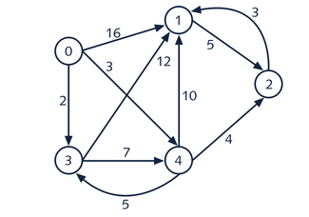
Floyd’s | Shortest Path
Adjacency Matrix
with NoEdge = ∞
0
1
2
3
4
∞ | 16 | ∞ | 2 | 3
∞ | ∞ | 5 | ∞ | ∞
∞ | 3 | ∞ | ∞ | ∞
∞ | 12 | ∞ | ∞ | 7
∞ | 10 | 4 | ∞ | ∞
0 | 1 | 2 | 3 | 4

Slide 62
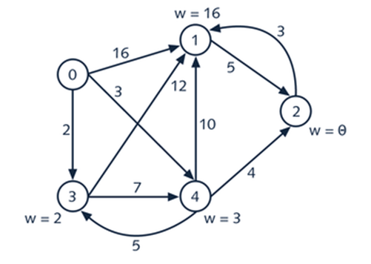
Floyd’s
Find the shortest path from 0 to every other node
0 | 16 | ∞ | 2 | 3
∞ | 0 | 5 | ∞ | ∞
∞ | 3 | 0 | ∞ | ∞
∞ | 12 | ∞ | 0 | 7
∞ | 10 | 4 | ∞ | 0
0 0
1 **
2 **
3 **
4 **
minPathLengths

Slide 63
Floyd’s
0 | 16 | ∞ | 2 | 3
∞ | 0 | 5 | ∞ | ∞
∞ | 3 | 0 | ∞ | ∞
∞ | 12 | ∞ | 0 | 7
∞ | 10 | 4 | ∞ | 0
0 0
1 16
2 **
3 **
4 **
minPathLengths

Slide 64
Floyd’s
0 | 16 | ∞ | 2 | 3
∞ | 0 | 5 | ∞ | ∞
∞ | 3 | 0 | ∞ | ∞
∞ | 12 | ∞ | 0 | 7
∞ | 10 | 4 | ∞ | 0
0 0
1 14
2 **
3 **
4 **
minPathLengths
Notes:
0 -> 1 (16)
0 -> 3 -> 1 (14)
0 -> 4 -> 1 (13)

Slide 65
Floyd’s
0 | 16 | ∞ | 2 | 3
∞ | 0 | 5 | ∞ | ∞
∞ | 3 | 0 | ∞ | ∞
∞ | 12 | ∞ | 0 | 7
∞ | 10 | 4 | ∞ | 0
0 0
1 10
2 **
3 **
4 **
minPathLengths
Then repeat process for [2], [3], [4]

Slide 66
Floyd’s | Learning Activity
0 1 2 3 4
0 0 7 5 4 6
1 8 0 2 3 1
2 5 3 0 6 4
3 4 3 6 0 2
4 6 1 4 2 0
2
4
3
1
10
4
0
1
3
5
2

Slide 67
Floyd’s Complete Process for →
4
2
3
1
4
10
0
1
Trip from 1 to 3 through 0 has length of 14
3
5
2
B | Trip from Vertex A to Vertex C Denoted A → C
0 | 1→1 *20 | 1→2 | 1→3 *14 | 1→4 | 2→1 | 2→2 *10 | 2→3 *9 | 2→4 | 3→1 *14 | 3→2 *9 | 3→3 *8 | 3→4 | 4→1 | 4→2 | 4→3 | 4→4
1 | 0→0 *20 | 0→2 | 0→3 | 0→4 *11 | 2→0 | 2→2 6 | 2→3 | 2→4 4 | 3→0 | 3→2 | 3→3 | 3→4 | 4→0 *11 | 4→2 4 | 4→3 | 4→4 2
2 | 0→0 *10 | 0→1 *8 | 0→3 | 0→4 *13 | 1→0 *8 | 1→1 *6 | 1→3 *12 | 1→4 | 3→0 | 3→1 *12 | 3→3 | 3→4 | 4→0 *9 | 4→1 | 4→3 | 4→4
3 | 0→0 8 | 0→1 | 0→2 | 0→4 6 | 1→0 | 1→1 | 1→2 | 1→4 | 2→0 | 2→1 | 2→2 | 2→4 | 4→0 6 | 4→1 | 4→2 | 4→4
4 | 0→0 | 0→1 7 | 0→2 | 0→3 | 1→0 7 | 1→1 2 | 1→2 | 1→3 *3 | 2→0 | 2→1 | 2→2 | 2→3 6 | 3→0 | 3→1 3 | 3→2 6 | 3→3 4
2→3 ... Denotes a trip from vertex 2 to vertex 3.
*20 ... Denotes that the path length 20 of the trip that included the intermediary vertex, B, was written
into row 2, column 3 of the aCopy matrix because that trip was shorter that the current
path length from vertex 2 to 3 stored in the matrix. * Indicates a shorter trip from vertex 2 to 3 was
eventually found.

Slide 68
Floyd’s Algorithm
// the array aCopy is a copy of the graph’s adjacency matrix
// non-existant paths in aCopy have been set to impossibly high values
1. for (int b = 0; b < numberOfVertices; b++) // all intermediate verticies B
2. { for (int a = 0; a < numberOfVertices; a++) // all starting vertices, A
3. { for (int c = 0; c < numberOfVertices; c++) // all destination vertices, C
4. { if (aCopy[a][c] > (aCopy[a][b] + aCopy[b][c])) // A to C > A to B to C
5. aCopy[a][c] = aCopy[a][b] + aCopy[b][c]; // store the indirect path
6. } // length in the weight matrix
7. }
8. }
9. return aCopy;
What initial concern might you have with this algorithm?
Notes:
What initial concern might you have with this algorithm?

Slide 69
Other Considerations

Slide 70
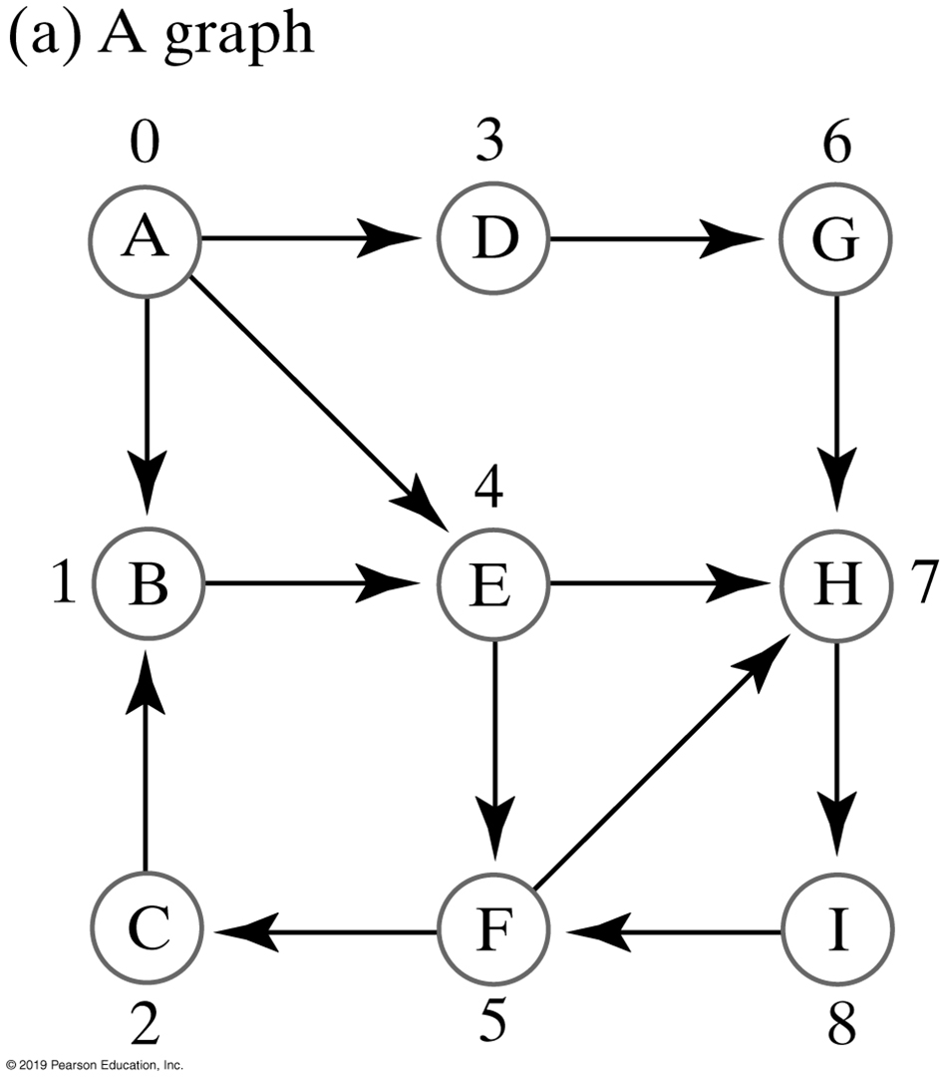
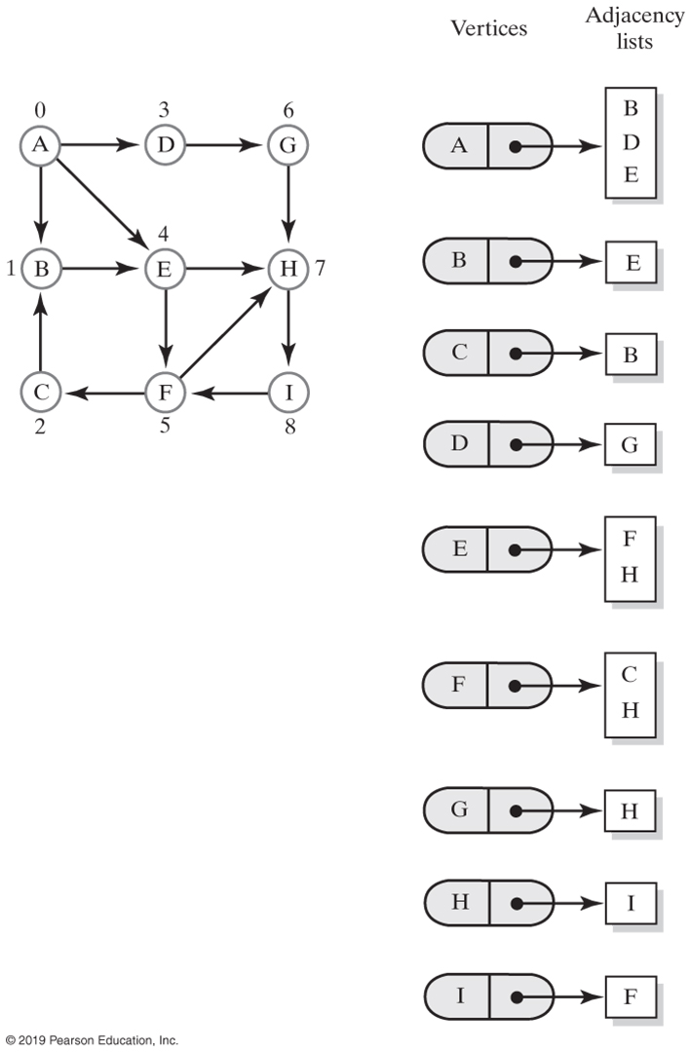
Directed Graph | Adjacency Lists

Slide 71
Two Singly Linked List (Graph Representation)
The vertex linked list references the nodes
The edge lists store the incident vertex numbers
The edge and vertex linked lists are parallel
incident vertex numbers
The
nodes
V₀
v₁
v₂
:
:
v₄
1
3
4
2
0
2
3
1
1
0
3
:
:
4
0
3
Vertex List
Edge List

Slide 72
Array Vertices | Singly Linked List Edges
The vertex array references the nodes
The edge lists store the incident vertex numbers
The edge linked lists and vertex array are parallel
incident vertex numbers
The
nodes
V₀
v₁
v₂
:
:
v₄
1
3
4
3
2
0
2
1
1
0
:
3
:
4
0
3
Vertex Array
Edge List
72
Notes:
72

Slide 73
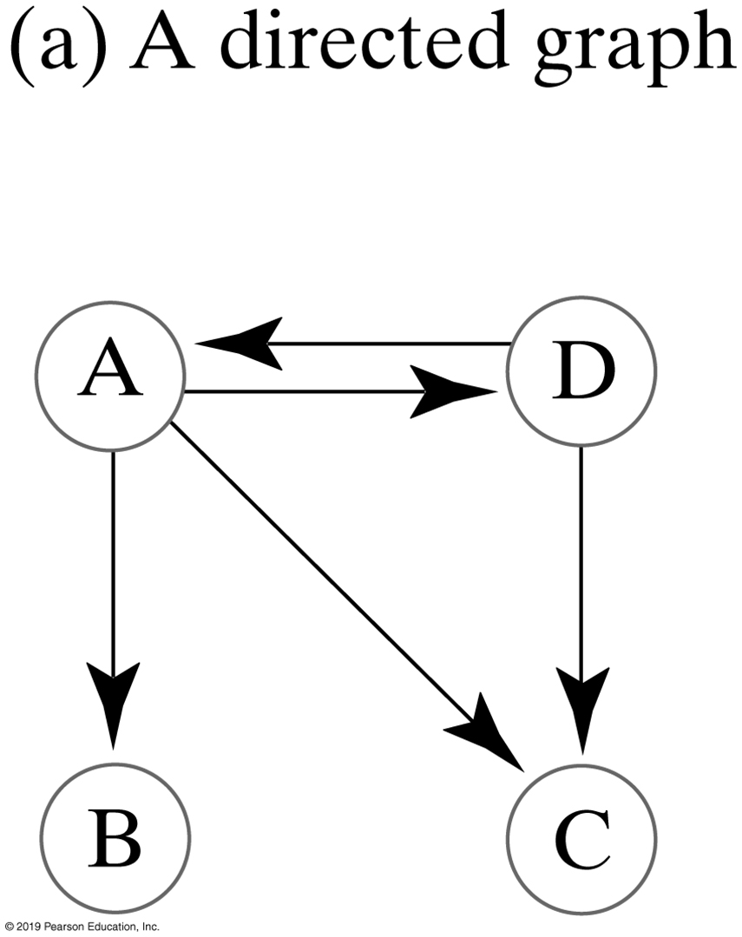
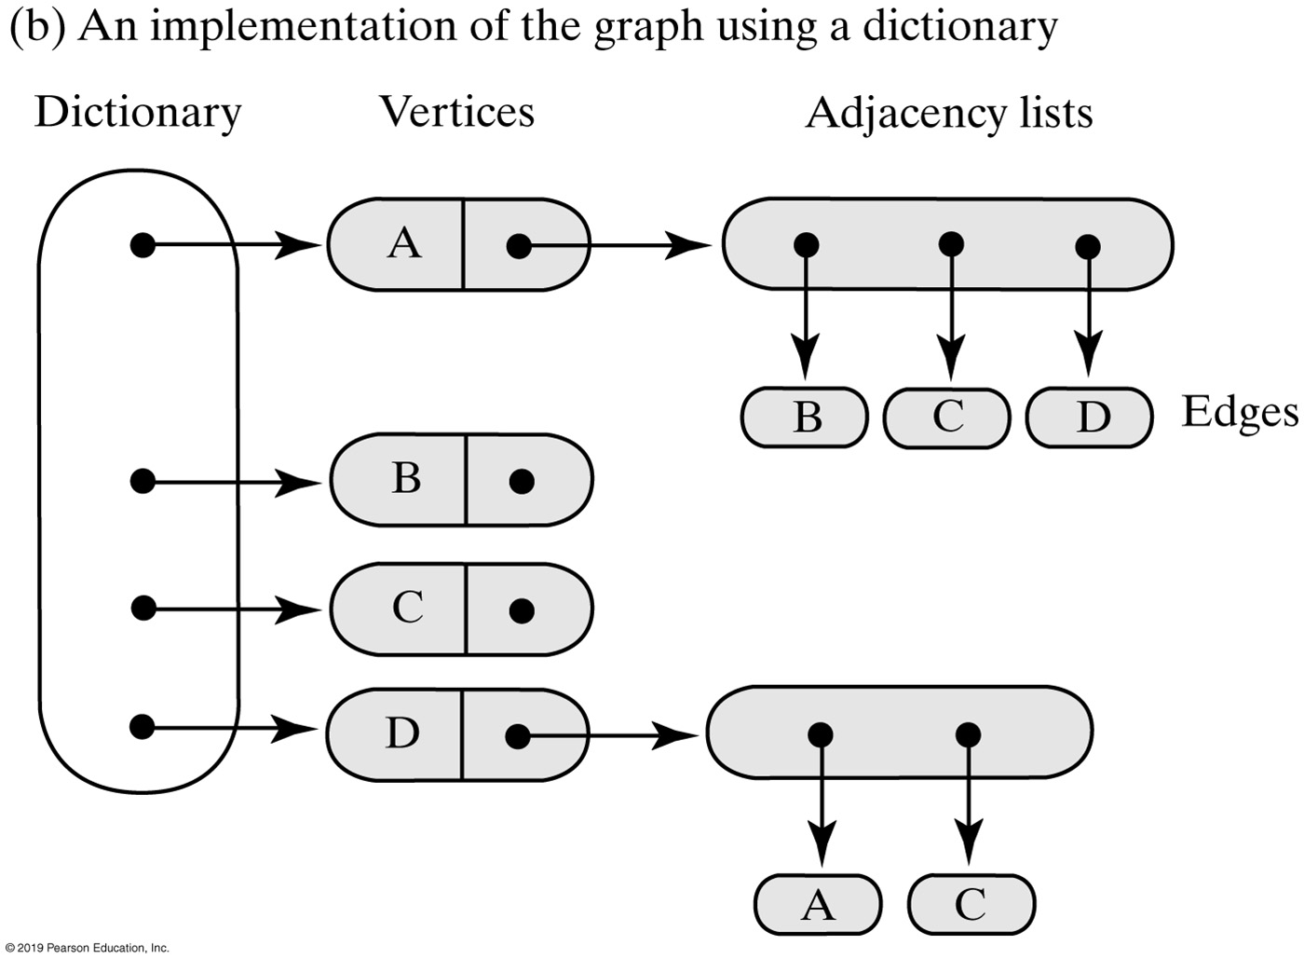
Dictionary Implementation

Slide 74
Implementation | Coding Details

Slide 75
Vertices and Edges — Interface (1 of 3)
/** An interface for a vertex in a graph. */
public interface VertexInterface<T>
{
/** Gets this vertex's label.
@return The object that labels the vertex. */
public T getLabel();
/** Marks this vertex as visited. */
public void visit();
/** Removes this vertex's visited mark. */
public void unvisit();
/** Sees whether the vertex is marked as visited.
@return True if the vertex is visited. */
public boolean isVisited();
/** Connects this vertex and a given vertex with a weighted edge.
The two vertices cannot be the same, and must not already
have this edge between them. In a directed graph, the edge
points toward the given vertex.
@param endVertex A vertex in the graph that ends the edge.
@param edgeWeight A real-valued edge weight, if any.
@return True if the edge is added, or false if not. */
public boolean connect(VertexInterface<T> endVertex, double edgeWeight);

Slide 76
Vertices and Edges — Interface (2 of 3)
/** Connects this vertex and a given vertex with an unweighted
edge. The two vertices cannot be the same, and must not
already have this edge between them. In a directed graph,
the edge points toward the given vertex.
@param endVertex A vertex in the graph that ends the edge.
@return True if the edge is added, or false if not. */
public boolean connect(VertexInterface<T> endVertex);
/** Creates an iterator of this vertex's neighbors by following
all edges that begin at this vertex.
@return An iterator of the neighboring vertices of this vertex. */
public Iterator<VertexInterface<T>> getNeighborIterator();
/** Creates an iterator of the weights of the edges to this
vertex's neighbors.
@return An iterator of edge weights for edges to neighbors of this vertex. */
public Iterator<Double> getWeightIterator();
/** Sees whether this vertex has at least one neighbor.
@return True if the vertex has a neighbor. */
public boolean hasNeighbor();
/** Gets an unvisited neighbor, if any, of this vertex.
@return Either a vertex that is an unvisited neighbor or null
if no such neighbor exists. */
public VertexInterface<T> getUnvisitedNeighbor();

Slide 77
Vertices and Edges — Interface (3 of 3)
/** Records the previous vertex on a path to this vertex.
@param predecessor The vertex previous to this one along a path. */
public void setPredecessor(VertexInterface<T> predecessor);
/** Gets the recorded predecessor of this vertex.
@return Either this vertex's predecessor or null if no predecessor
was recorded. */
public VertexInterface<T> getPredecessor();
/** Sees whether a predecessor was recorded for this vertex.
@return True if a predecessor was recorded. */
public boolean hasPredecessor();
/** Records the cost of a path to this vertex.
@param newCost The cost of the path. */
public void setCost(double newCost);
/** Gets the recorded cost of the path to this vertex.
@return The cost of the path. */
public double getCost();
} // end VertexInterface

